Slide 1



  G H RAISONI COLLEGE OF ENGINEERING AND MANAGEMENT
(Approved by AICTE, New Delhi and Recognized by DTE, Maharashtra)
An Autonomous Institute Affiliated to Rashtrasant Tukadoji Maharaj Nagpur University, Nagpur
Accredited by NAAC with A+ Grade
DEPARTMENT OF COMMERCE & MANAGEMENT
(Bachelor of Business Administration)
Project Introductory Seminar
On
Marketing Strategy Of Zudio and its Influence on Purchase Decision of Customer
Guide: Co-Guide:
Prof. Sapna Sawarkar Prof. Nikita Jha
Assistant prof. Assistant prof .
Name of Projectees
1. Kundan Dani 2. Meghraj Hiwase
3. Manish Girsawle 4. Atharv Rakshiye
Session 2025-2026
Nagpur | Pune | Jalgaon | Amravati | Pandhurna | Bhandara

Slide 2
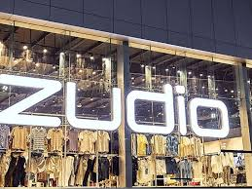
Contents
Introduction
Concept of the Topic
Need of the Study
Objectives of the Study
Scope of the Study
Review of Literature
Research Gap
Statement of the Problem
Research methodology
Data Analysis and Interpretation
Work Done So Far
Expected Findings / Result
Limitations of the Study

Slide 3
Introduction
Introduction / background of the study
Marketing strategies strongly influence customer purchase decisions in retail
Zudio is a popular value fashion brand under the Tata Group.
It offers trendy clothing at affordable prices.
The brand focuses on low pricing, wide product range, and attractive store layouts.
This study examines how Zudio’s strategies affect customer buying behavior.

Slide 4
Concept of the Topic
Concept of the Topic Basic Explanation
Zudio is a fashion retail brand under Tata Group
Focus on trendy, low-cost apparel
Targets youth and middle-income consumers
Operates through physical retail stores

Slide 5
Need of the study
Need of the Study
To understand consumer preference for budget fashion
To analyze Zudio’s market positioning
To study customer satisfaction levels
To evaluate competitive advantage

Slide 6
Objectives of the study
Objectives of the Study
To analyze Zudio’s marketing strategy
To study customer perception towards the brand
To examine pricing and promotional
To identify strengths and weaknesses
To understand growth opportunities

Slide 7
Scope of the study
Scope of the Study
Covers Zudio stores in selected locations
Focus on marketing strategies and customer behavior
Includes product range, pricing, and branding
Limited to Indian retail market
Useful for students and researchers in marketing

Slide 8
Review of Literature
Sr. No. | Paper Title and its Author | Details of Publication | Findings
1 | Design and Fabrication of Waste Collecting Machine Brijesh K J, Karthik P, Adarsh S B, Githin V, Kevin Xavier | International Journal of Research Publication and Reviews (IJRPR), Vol. 4, No. 10, pp. 539–540 | Examines Zudio’s marketing strategies such as branding, customer engagement, pricing, and digital marketing, and analyzes their influence on consumer perception and brand loyalty.
2 | A Study on Marketing Strategy of Zudio | MET SRUJAN (Peer-Reviewed Journal), Vol. 1, No. 1 | Applies the Blue Ocean Strategy framework to Zudio, highlighting its unique market positioning and its impact on customer demand and retail growth.
3 | A Comprehensive Analysis of Zudio Fashion Brand – A Case Study | GBS Impact: Journal of Multi-Disciplinary Research, Vol. 11, Issue 1 | Analyzes customer preferences towards Zudio products and services, offering insights into factors influencing purchase decisions.

Slide 9
Research Gap
Lack of detailed analysis on its pricing model
Limited research specifically on Zudio brand
Few studies on customer perception in Tier-2 cities
Need for updated research on fast fashion growth in India

Slide 10
Statement of the Problem
Problem identified and its justification
The study helps understand how Zudio’s marketing strategies affect customer buying decisions.
It is useful to analyze customer behavior in India’s price-sensitive fashion market.
The findings can help marketers improve pricing, promotion, and store experience.
The study adds academic value by focusing on a fast-growing Indian retail brand.

Slide 11
Research Methodology
I. Research Methodology Components
Research Type: Descriptive to describe the characteristics of the consumer base and Analytical (to analyze the success factors).
Sampling Method: Convenience sampling and Purposive sampling are common, targeting shoppers at specific Zudio retail outlets.
II. Sources of Data Collection
Primary Data: Gathered directly from Zudio customers to understand their perceptions and purchasing behavior.
Secondary Data: Collected to support the analysis of Zudio’s business model and marketing strategies.
  .

Slide 12
Source of Data collection
Customer review
Affordability & Value: Customers feel Zudio offers some of the best prices in the market, often comparing it to a "budget-friendly Westside" or "India's Shein".
Word-of-Mouth Over Ads: The brand is lauded for growing rapidly without traditional TV or print ads, relying on viral popularity.
Rapid Fashion Turnover: The inventory changes quickly, providing a fresh, trendy collection

Slide 13
Data Analysis and Interpretation
Data Analysis and Interpretation
Use of charts and graphs
Pie charts for customer preferences
Bar graphs for pricing comparison
Tables for survey results
Interpretation shows affordability as key factor
Customers prefer trendy designs at low prices

Slide 14
Work Done So Far
Work Done So Far (Progress Report)
Topic selection completed
Literature review done
Questionnaire prepared
Data collection started
Initial analysis in progress

Slide 15
Expected Findings / Results
Expected Findings / Results
Zudio’s low pricing is major attraction
High demand among youth and middle-class consumers
Strong store expansion strategy
Limited advertising but strong word-of-mouth
Competitive advantage in affordability

Slide 16
Limitations of the Study
Limitations of the Study
Limited sample size
Time constraints
Data may not represent all regions
Dependence on respondent accuracy
Limited access to company internal data

Slide 17
Justifications for Selecting the Title
Justifications for Selecting the Title
The brand follows a Zudio is one of the fastest-growing fashion retail brands in India, making it a relevant subject for study.
unique marketing strategy based on low pricing, offline stores, and trend-based products, which strongly influences customer buying behavior.
Studying this topic helps understand how marketing strategies affect customer purchase decisions in the fashion retail industry.

Slide 18
Objectives of the Project
Objective of the Project
To understand the pricing, product, promotion, and store strategies followed by Zudio.
To examine the factors that influence customers to purchase products from Zudio.
To analyze customer perception and satisfaction towards Zudio’s products and pricing
To identify the role of store experience and visual merchandising in purchase decisions.

Slide 19
Expected Result
Expected output of the project
The study is expected to identify the key marketing strategies adopted by Zudio.
It is expected to show how pricing, product variety, and store experience influence customer purchase decisions
.
The project may reveal that affordable pricing plays a major role in attracting customers to Zudio.

Slide 20
Work – Plan
Months Activities | Dec’25 | Jan’26 | Feb’26 | Mar’26 | Apr’26
Objective of Study | ✔
Problem Statement |  | ✔
Literature Review |  | ✔
Data Collection |  |  | ✔
Data Analysis and Interpretation |  |  | ✔
Summary and Conclusion |  |  |  | ✔
Preparation of Project Report
Thesis and Poster Submission

Slide 22
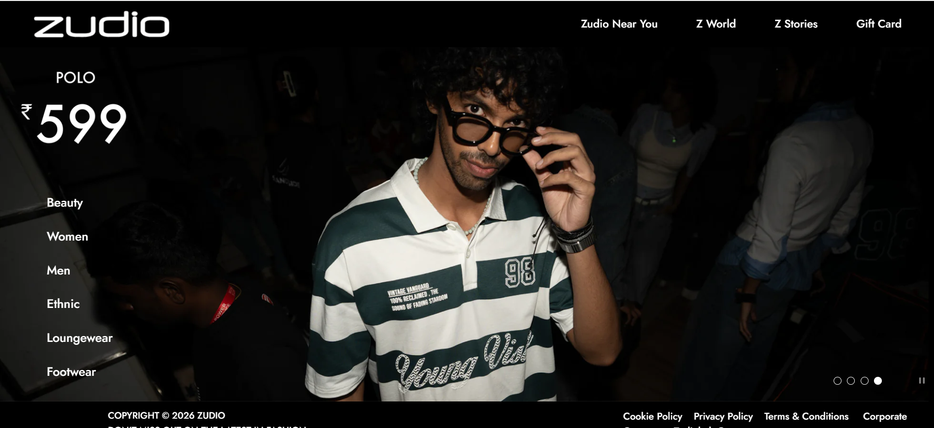
References
Zudio Website
https://www.zudio.com/collections/men

Slide 23
Thank you !
Nagpur | Pune | Jalgaon | Amravati | Pandhurna | Bhandara

